Slide 1
Back Propagation in Neural Networks

Slide 2
Let's create an ANN!
Step 1: Decide on the number of layers and number of neurons per layer. This will depend on task the ANN will be used for.
Step 2: Decide on an activation function for each layer. There are many options (few listed below) and each has a specific benefits.
ReLU TanH Sigmoid LeakyReLU
Step 3: Randomly assigning weights and biases to each neuron.
Step 4: Start predicting (forward propagation) and learning (backward propagation).

Slide 3
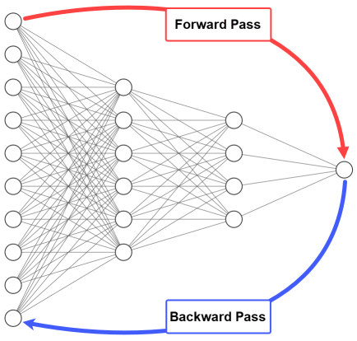
The forward and backward phases are repeated from some epochs.
In each epoch, the following occurs:
The inputs are propagated from the input to the output layer.
The network error is calculated.
The error is propagated from the output layer to the input layer.

Slide 4
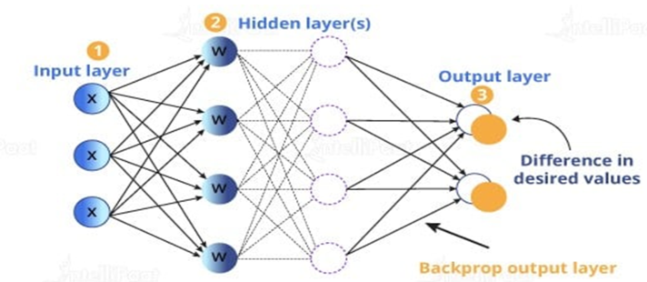
How to Train a Network
Steps
Forward Propagation
Calculate Loss
Back Propagation
Updates Wait
Repeat the steps to get an output with an acceptable loss

Slide 5
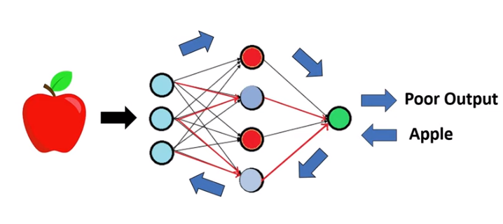

Slide 6
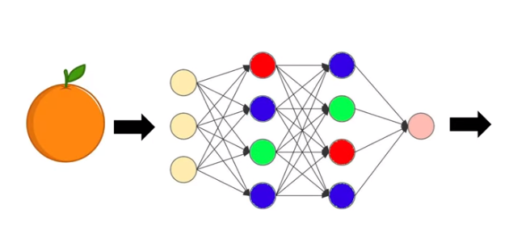

Slide 7
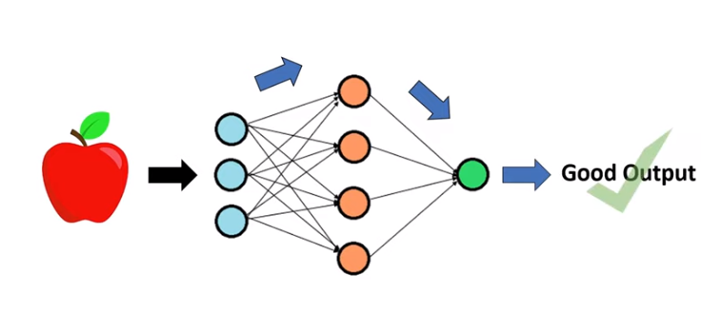

Slide 8
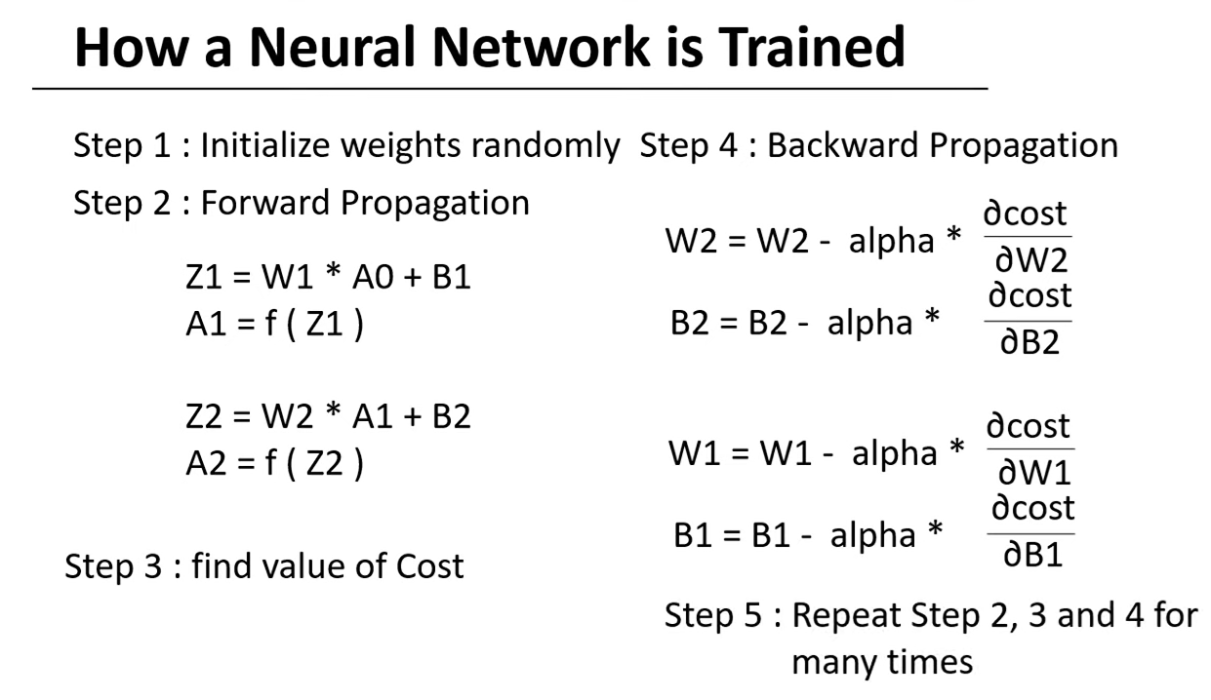

Slide 9
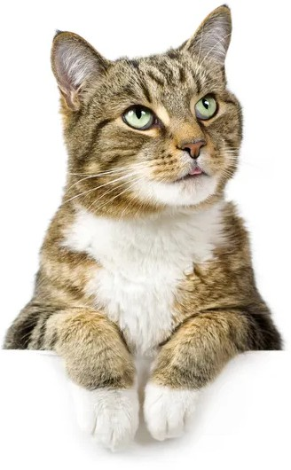
Let’s create an ANN!
Inputs
Chance of image being a cat
Chance of image being a dog

Slide 10
Let’s create an ANN!
W1=8, W2=5 B=1
W1=3, W2=6 B=11
W1=5, B=2
W1=7, B=4
W1=2, B=6
W1=7, W2=1 B=0
W1=4, W2=9 B=3
A=ReLU
A=ReLU
A=Sigmoid

Slide 11
Forward Propagation
Inputs
3
W1=5, B=2
W1=8, W2=5 B=1
W1=3, W2=6 B=11
17
2
W1=7, B=4
18
3
W1=2, B=6
12
W1=7, W2=1 B=0
W1=4, W2=9 B=3

Slide 12
Forward Propagation
Inputs
3
W1=5, B=2
W1=8, W2=5 B=1
W1=3, W2=6 B=11
17
32
2
W1=7, B=4
18
54
3
W1=2, B=6
12
W1=7, W2=1 B=0
W1=4, W2=9 B=3

Slide 13
Forward Propagation
Inputs
3
W1=5, B=2
W1=8, W2=5 B=1
W1=3, W2=6 B=11
17
32
0.2
2
W1=7, B=4
18
54
0.8
3
W1=2, B=6
12
W1=7, W2=1 B=0
W1=4, W2=9 B=3

Slide 14
Forward Propagation
Inputs
3
W1=5, B=2
W1=8, W2=5 B=1
W1=3, W2=6 B=11
17
32
0.2
2
W1=7, B=4
18
DOG
54
0.8
3
W1=2, B=6
12
W1=7, W2=1 B=0
W1=4, W2=9 B=3

Slide 15

Forward Propagation
Inputs
3
W1=5, B=2
W1=8, W2=5 B=1
W1=3, W2=6 B=11
17
32
0.2
2
W1=7, B=4
18
DOG
54
0.8
3
W1=2, B=6
12
W1=7, W2=1 B=0
W1=4, W2=9 B=3

Slide 16
Backward Propagation
Inputs
3
W1=5, B=2
W1=8, W2=5 B=1
W1=5, W2=11 B=3
2
W1=7, B=4
LOSS
3
W1=2, B=6
W1=7, W2=1 B=0
W1=2, W2=4 B=1

Slide 17
Backward Propagation
Inputs
3
W1=5, B=2
W1=6 W2=2 B=5
W1=5, W2=11 B=3
2
W1=7, B=4
LOSS
3
W1=2, B=6
W1=3, W2=5 B=2
W1=2, W2=4 B=1

Slide 18
Backward Propagation
Inputs
3
W1=7, B=1
W1=6 W2=2 B=5
W1=5, W2=11 B=3
2
W1=4, B=2
LOSS
3
W1=8, B=1
W1=3, W2=5 B=2
W1=2, W2=4 B=1

Slide 19

ANN Learning
Inputs
8
W1=7, B=1
W1=6 W2=2 B=5
W1=5, W2=11 B=3
32
5
W1=4, B=2
24
7
W1=8, B=1
43
W1=3, W2=5 B=2
W1=2, W2=4 B=1

Slide 20
ANN Learning
Inputs
8
W1=7, B=1
W1=6 W2=2 B=5
W1=5, W2=11 B=3
32
63
5
W1=4, B=2
24
78
7
W1=8, B=1
43
W1=3, W2=5 B=2
W1=2, W2=4 B=1

Slide 21
ANN Learning
Inputs
8
W1=7, B=1
W1=6 W2=2 B=5
W1=5, W2=11 B=3
32
63
0.6
5
W1=4, B=2
24
78
0.4
7
W1=8, B=1
43
W1=3, W2=5 B=2
W1=2, W2=4 B=1

Slide 22
ANN Learning
Inputs
8
W1=7, B=1
W1=6 W2=2 B=5
W1=5, W2=11 B=3
32
63
0.6
5
W1=4, B=2
24
CAT
78
0.4
7
W1=8, B=1
43
W1=3, W2=5 B=2
W1=2, W2=4 B=1

Slide 23
ANN Learning
Inputs
8
W1=7, B=1
W1=6 W2=2 B=5
W1=5, W2=11 B=3
32
63
0.6
5
W1=4, B=2
24
CAT
78
0.4
7
W1=8, B=1
43
W1=3, W2=5 B=2
W1=2, W2=4 B=1

Slide 24
ANN Learning
Inputs
8
W1=7, B=1
W1=6 W2=2 B=5
W1=7, W2=3 B=2
5
W1=4, B=2
LOSS
7
W1=8, B=1
W1=3, W2=5 B=2
W1=3, W2=6 B=3

Slide 25
ANN Learning
Inputs
8
W1=7, B=1
W1=4 W2=8 B=3
W1=7, W2=3 B=2
5
W1=4, B=2
LOSS
7
W1=8, B=1
W1=6, W2=2 B=2
W1=3, W2=6 B=3

Slide 26
ANN Learning
Inputs
8
W1=4, B=5
W1=4 W2=8 B=3
W1=7, W2=3 B=2
5
W1=2, B=1
LOSS
7
W1=5, B=7
W1=6, W2=2 B=2
W1=3, W2=6 B=3

Slide 27
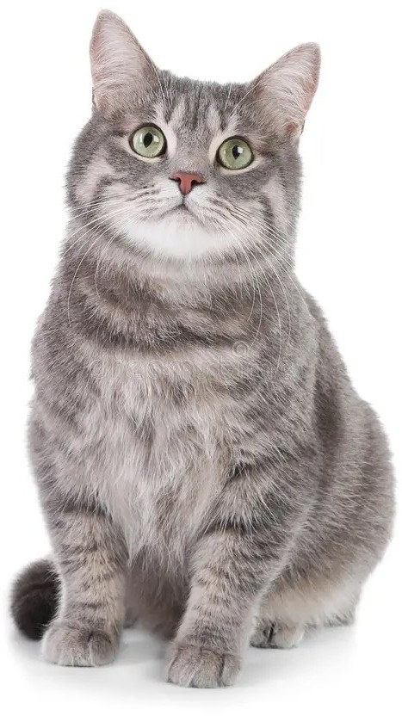
ANN Learning
Inputs
2
W1=4, B=5
W1=4 W2=8 B=3
W1=7, W2=3 B=2
12
3
W1=2, B=1
15
2
W1=5, B=7
19
W1=6, W2=2 B=2
W1=3, W2=6 B=3

Slide 28
ANN Learning
Inputs
2
W1=4, B=5
W1=4 W2=8 B=3
W1=7, W2=3 B=2
12
36
3
W1=2, B=1
15
19
2
W1=5, B=7
19
W1=6, W2=2 B=2
W1=3, W2=6 B=3

Slide 29
ANN Learning
Inputs
2
W1=4, B=5
W1=4 W2=8 B=3
W1=7, W2=3 B=2
12
36
0.9
3
W1=2, B=1
15
19
0.1
2
W1=5, B=7
19
W1=6, W2=2 B=2
W1=3, W2=6 B=3

Slide 30
ANN Learning
Inputs
2
W1=4, B=5
W1=4 W2=8 B=3
W1=7, W2=3 B=2
12
36
0.9
3
W1=2, B=1
15
CAT
19
0.1
2
W1=5, B=7
19
W1=6, W2=2 B=2
W1=3, W2=6 B=3

Slide 31

ANN Learning
Inputs
2
W1=4, B=5
W1=4 W2=8 B=3
W1=7, W2=3 B=2
12
36
0.9
3
W1=2, B=1
15
CAT
19
0.1
2
W1=5, B=7
19
W1=6, W2=2 B=2
W1=3, W2=6 B=3

Slide 33
Challenges of Training
Availability of dataset
Computing power
Training time
Overfitting
Gradients Vanishing

Slide 34
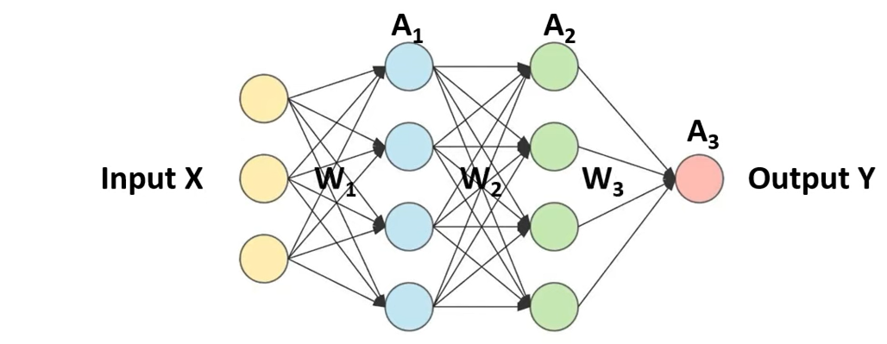

Slide 35
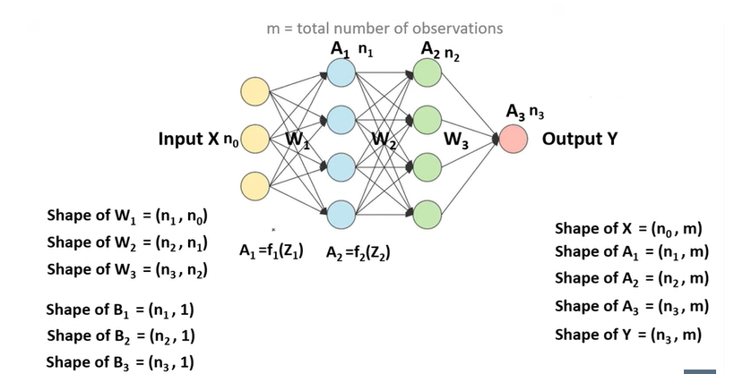



Slide 36
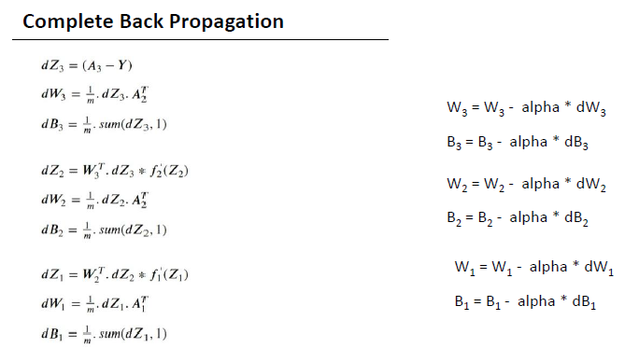

Slide 37
THANKS!!

Slide 38
